Slide 1
Warm Up #5 4/26
Could a carbon atom in an ancient plant stem become part of a plant today?
How?
Are fossil fuels part of the carbon cycle?
How are fossil fuels made?
TRUE/FALSE: When organisms use cellular respiration to break down foods, SOME of the energy moves into the environment

Slide 2
Agenda 4/25
GRADES BACK (Remind me ~10 min till end)
Go over results/purpose of lab
Nitrogen cycle notes
Begin project online (critical partners)
Re-takes of quiz—come in today!!! (phone calls tomorrow!)

Slide 3
Lab overview
What did we do?
Why did we do it
What where we trying to find out?
What did we find out

Slide 4
Nitrogen Cycle Animation
http://www.classzone.com/books/ml_science_share/vis_sim/em05_pg20_nitrogen/em05_pg20_nitrogen.swf

Slide 5
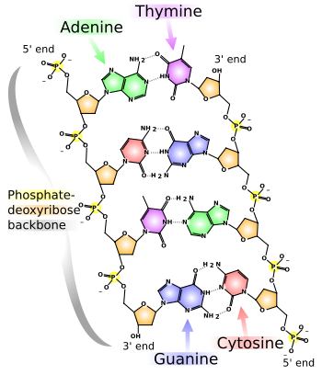
CH 8 Notes #6 Nitrogen Cycle
Process of nitrogen moving from the environment into organisms and back
Importance: Nitrogen is used to make nucleic acids & proteins

Slide 6
Remember…
Proteins make our traits
They give our bodies structure
Carry Oxygen through the bloodstream
Send signals through our bodies
Makeup part of the cell membrane

Slide 7
A trip through the nitrogen cycle
Nitrogen fixation: process where bacteria turn nitrogen gas into a form of nitrogen other organisms can use
Note: 80 % of the atmosphere is nitrogen gas but most organisms cannot use it until it has been changed

Slide 8
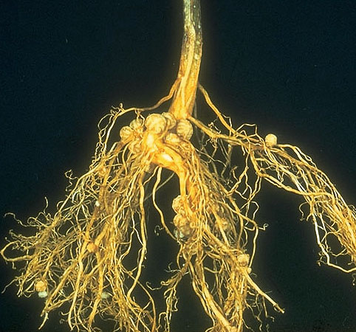

Slide 9
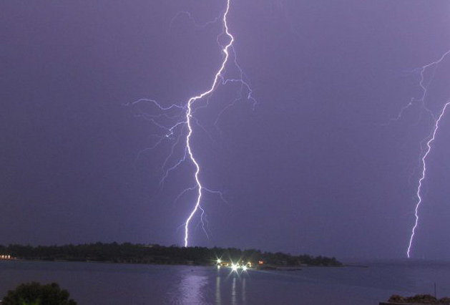
B. Lightning also adds nitrogen to the soil when it strikes the ground

Slide 10
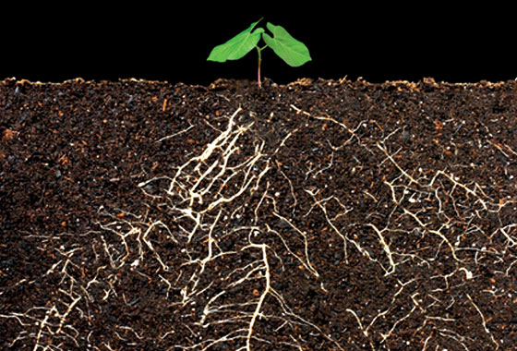
C. Plants absorb nitrogen through their roots and use it to build proteins

Slide 11
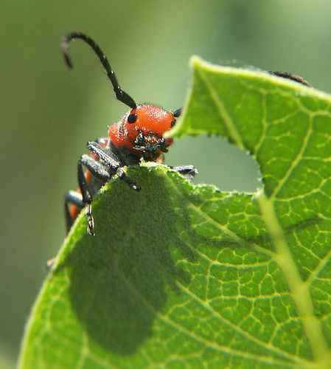
D. Animals eat the plants (or other animals) and use the nitrogen in plant proteins to make their own proteins

Slide 12
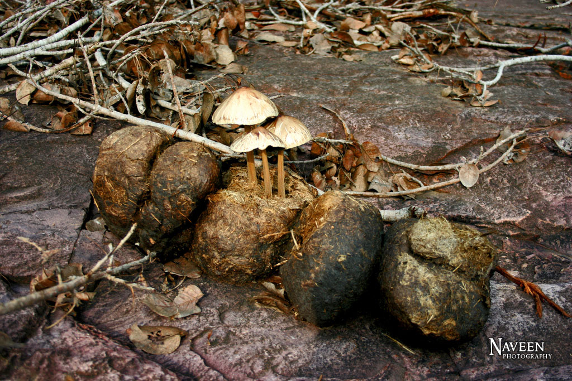
E. Decomposers break-down dead organisms putting nitrogen back into the earth or atmosphere where it can be used again

Slide 13
Remember: As nitrogen cycles through the atmosphere, soil, and living things the total amount of nitrogen in the ecosystem does not change
Note: This is true for all matter, including carbon!

Slide 14
Other important points
Reminder: CHNOPS; the six most common elements in living things.
Fertilizers add phosphorus and nitrogen to the soil, which helps plants grow
-Note: fertilizer is not plant “food”, it’s more like plant “vitamins”
Phosphorus is another important element in living things that is also needed, especially by plants

Slide 15
