Slide 1
PRACTICE FOR QUIZ #3
Push the “F5” button (above the letter 4) to play the PowerPoint

Slide 2
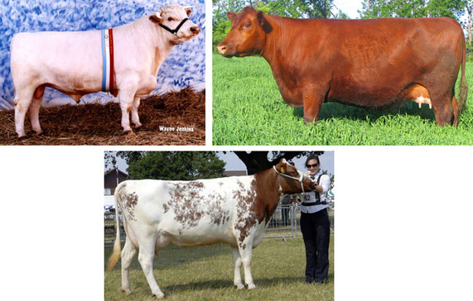
1) C = complete I = incomplete Co = codominant P = polygenic

Slide 3
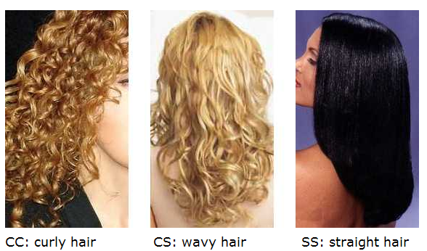
2) C = complete I = incomplete Co = codominant P = polygenic

Slide 4
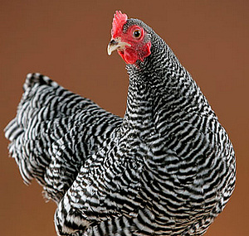
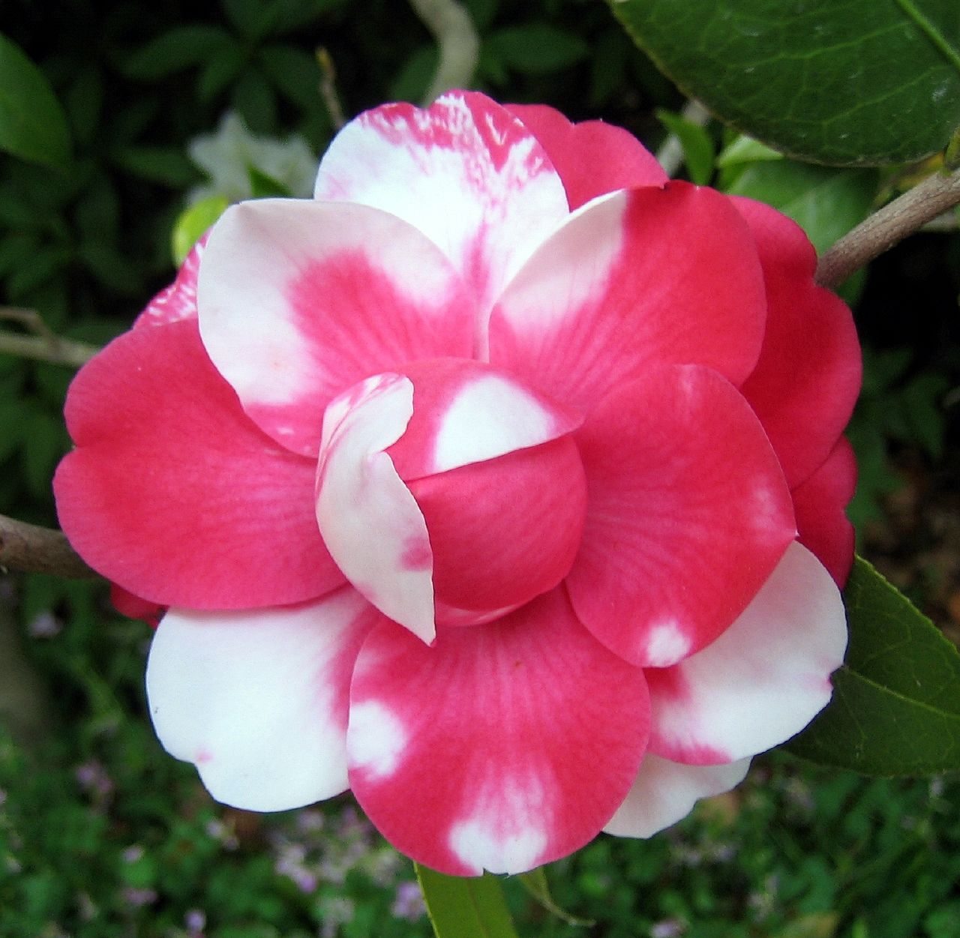
3) C = complete I = incomplete Co = codominant P = polygenic

Slide 5
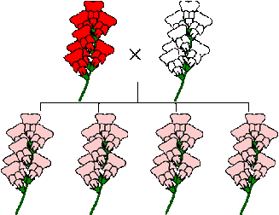
4) C = complete I = incomplete Co = codominant P = polygenic

Slide 6
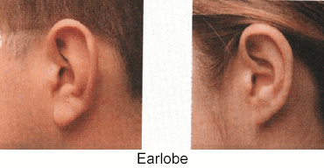
C = complete I = incomplete Co = codominant P = polygenic
R = right handed
r = left handed Brown fur + white fur =
all brown fur
DOMINANT and recessive

Slide 7
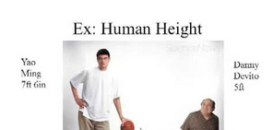
6) C = complete I = incomplete Co = codominant P = polygenic
Skin color AABbCc
Eye color

Slide 8
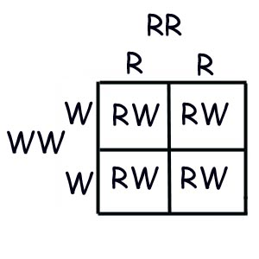
7) C = complete I = incomplete Co = codominant P = polygenic

Slide 9
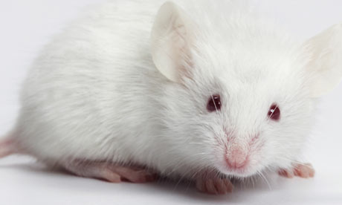
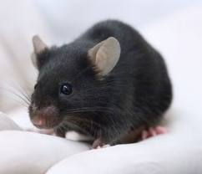
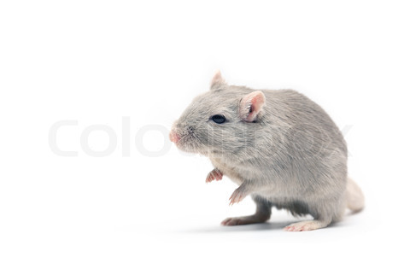
8) C = complete I = incomplete Co = codominant P = polygenic

Slide 10
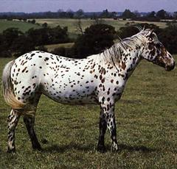
9) C = complete I = incomplete Co = codominant P = polygenic

Slide 11
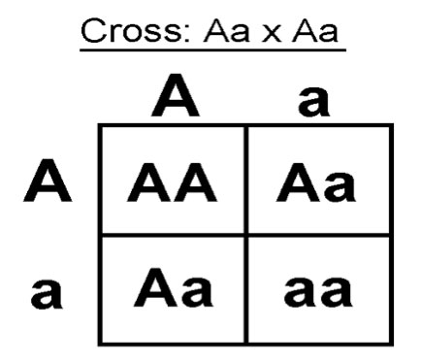
10) C = complete I = incomplete Co = codominant P = polygenic

Slide 12
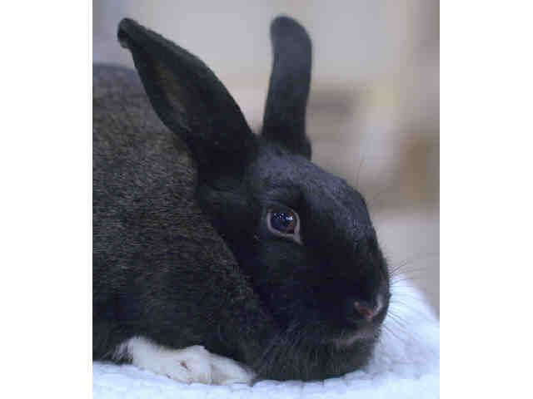
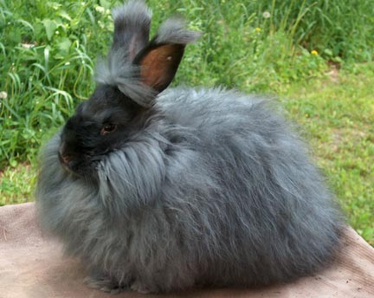
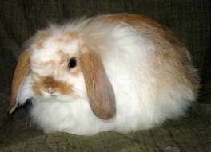
11) C = complete I = incomplete Co = codominant P = polygenic
Long hair + short haired
Medium haired

Slide 13
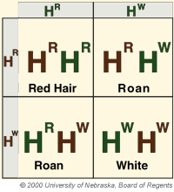
12) C = complete I = incomplete Co = codominant P = polygenic

