Slide 1
Your “Do Now” 5/29
Complete the pre-test
Fill in Learning Targets 1 & 2
I can explain the causes and effects of global warming and why it’s important to research
I can describe the causes and effects of pollution, deforestation, and invasive species on the environment
Get out CH 16 Notes 1

Slide 2
Agenda 5/29
Notes #2 (brief) on air pollution
Practice on air pollution
Last week before finals: keep going strong!

Slide 3
Air Pollutant: material in the air that could be harmful to living things (if concentration is high enough)
Note: These could be tiny solid pieces (like dust) or gases (like carbon dioxide)

Slide 4
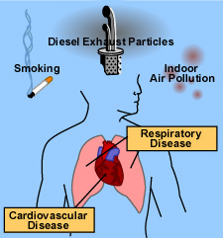
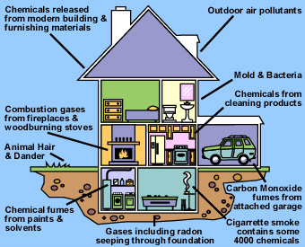
For humans, pollutants in the air usually affect our respiratory system (trachea, lungs, etc)
Breathing in pollutants often causes damage to airways and harms our breathing

Slide 5
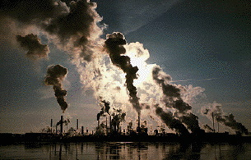
Key point: Air pollution moves around with air currents! The pollution one city produces could end up somewhere else.

Slide 6
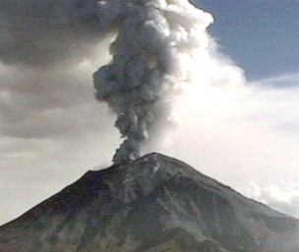
Natural sources of air pollution:
Volcanoes, forest fires, dust storms, and animal waste are all natural sources of pollution

Slide 7
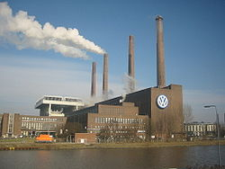
Man-made sources of air pollution:
Factories, automobiles, household cleaners, tobacco smoke

Slide 8
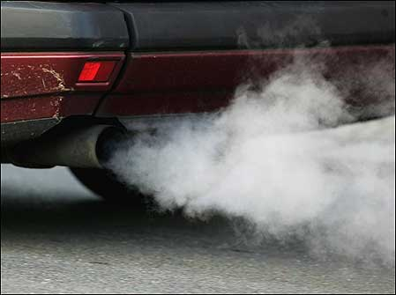
Some common pollutants in the air:
Carbon monoxide: could cause mental problems or death

Slide 9
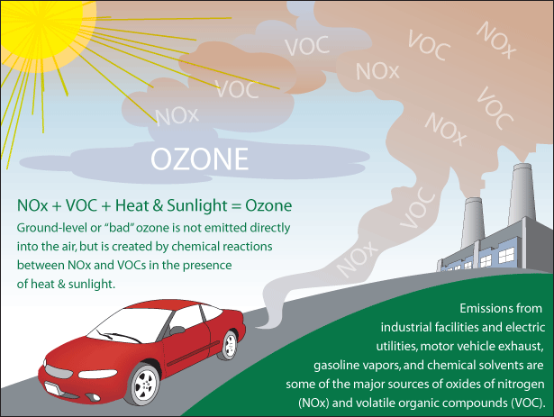
Ozone: damages plants, lungs, buildings

Slide 10
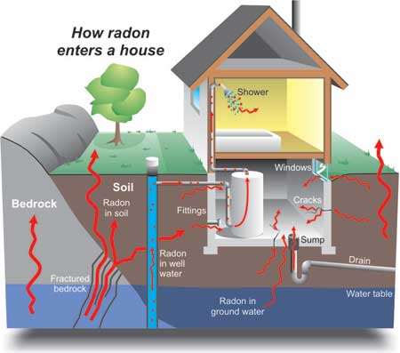
Radon: could cause lung cancer

Slide 11
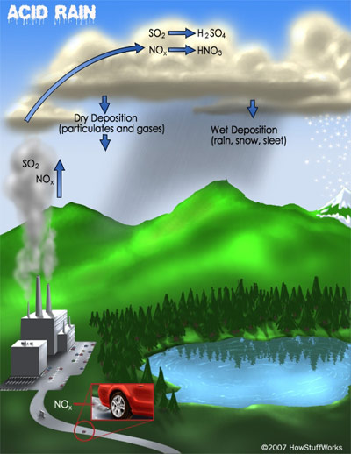
Sulfur dioxide: damages lungs, causes acid rain

Slide 12
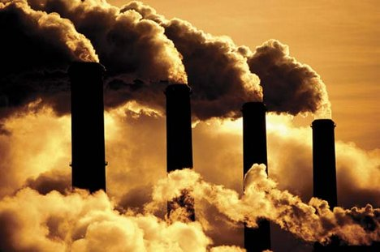
Mercury: causes cancer, released by burning coal

Slide 13
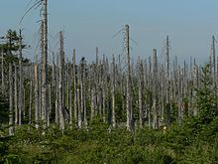
Acid rain: rainfall that is significantly acidic
Created when Nitrogen and Sulfur chemicals are put into the air by burning fossil fuels
This acidity can kill trees, fish, and frogs

